Slide 1

Bharat Herald Dashboard
Providing Insights to Guide a Legacy Newspaper’s Survival in a Post- COVID Digital Era
Presented by Sushma R

Slide 2


Agenda
Overview Ad-hoc Request Primary Analysis Secondary Analysis Recommendation

Slide 3

Bharat Herald Overview
Bharat Herald is a seven-decade-old, multilingual newspaper with operations across five Indian states. Once printing over 1.2 million copies daily, the organization is now facing an existential crisis as print circulation has fallen below 560,000 between 2019 and 2024. The COVID-19 pandemic accelerated the shift to digital news consumption, and agile competitors such as DigiHindi Post, NewsZilla, and InShorts captured market share with mobile-first platforms, WhatsApp delivery, and subscription bundles. Bharat Herald’s own 2021 e-paper pilot failed due to poor mobile usability and financial losses

Slide 4


Ad-hoc Request
Analyzed in SQL

Slide 5
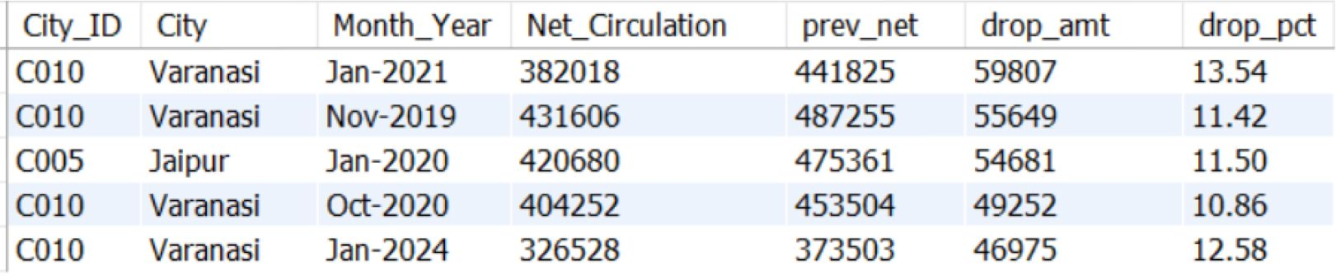
1. Monthly Circulation Drop Check
Key Insights: Varanasi dominates the decline list with repeated steep drops (2019, 2020, 2021, 2024). Jaipur faced a major one-time drop in Jan 2020. Consistent circulation decline in Varanasi highlights an urgent need for digital-first strategies in this market.

Slide 6
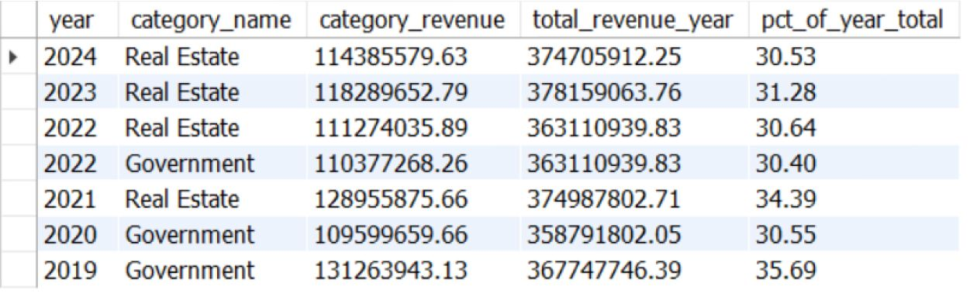
2. Yearly Revenue Concentration by Category
Key Insights: Real Estate has become the largest ad revenue driver, contributing ~31–34% of total revenue since 2022. Government ad share fell from 36% in 2019 to ~30% in 2022. Top 2 categories (Government & Real Estate) still account for over 60% of total ad revenue each year. The company will be at risk if one main advertiser group reduces its spending

Slide 7
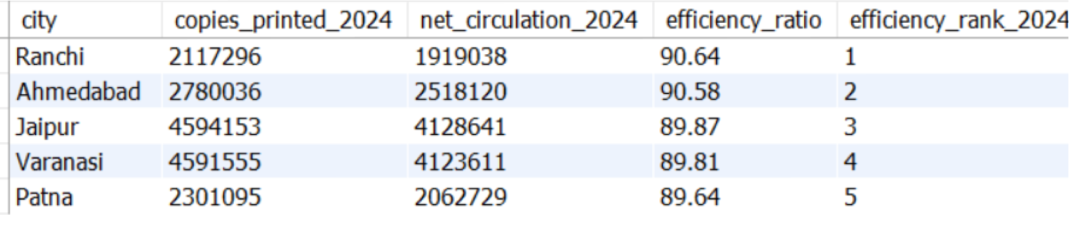
3. 2024 Print Efficiency Leaderboard
Key Insights: Ranchi leads with 90.6% print efficiency, indicating very low waste. Ahmedabad, Varanasi and Jaipur are close behind (90.5% and 89.9%), showing consistent reach. Even the 5th city (Patna) maintains nearly 90% efficiency – a strong base for distribution. These five markets set the benchmark for operational excellence in 2024

Slide 8
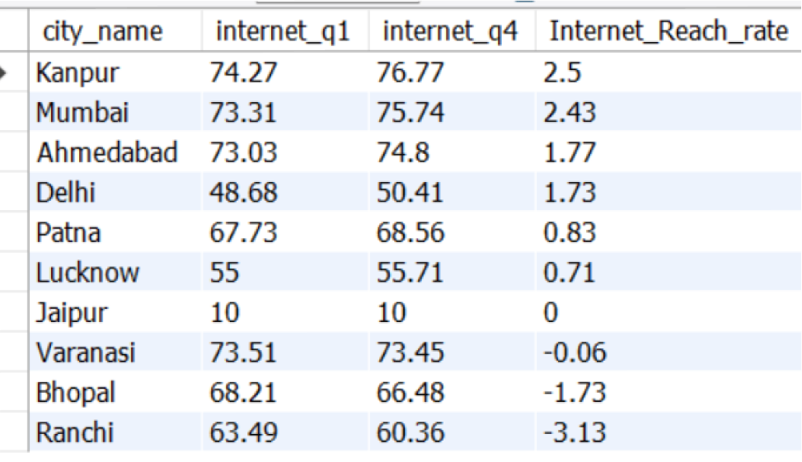
4. Internet Readiness Growth (2021)
Key Insights: Kanpur, Mumbai, Ahmedabad and Delhi show the growth in internet reach. Ranchi, Bhopal, and Varanasi are declining — potential risk for digital products.

Slide 9
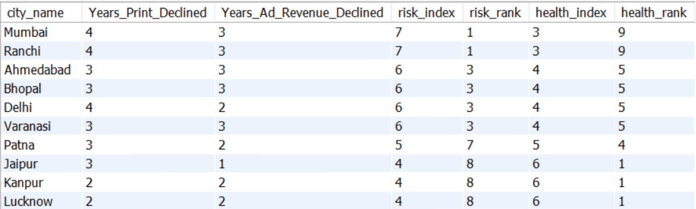
5. Find cities where both net_circulation and ad_revenue consistent Multi-Year Decline (2019→2024)
Key Insights: Mumbai & Ranchi are at the highest risk (Risk Index = 7) because they show 4 years of print circulation decline and 3 years of ad revenue decline each. ......

Slide 10
5. Find cities where both net_circulation and ad_revenue consistent Multi-Year Decline (2019→2024).......
Ahmedabad, Bhopal, Delhi, and Varanasi are next (Risk Index = 6), with multiple years of both print and ad revenue declines Patna, Jaipur, Kanpur, and Lucknow are at lower risk (Risk Index ≤5), showing fewer years of declines compared to the above cities. Jaipur, Kanpur, and Lucknow have the highest health index (6), meaning they are relatively better in print/ad growth years despite some declines. Patna follows with a health index of 5, reflecting moderate recovery potential. Mumbai & Ranchi, despite high risk, have the lowest health index (3), indicating limited recovery trends.

Slide 11
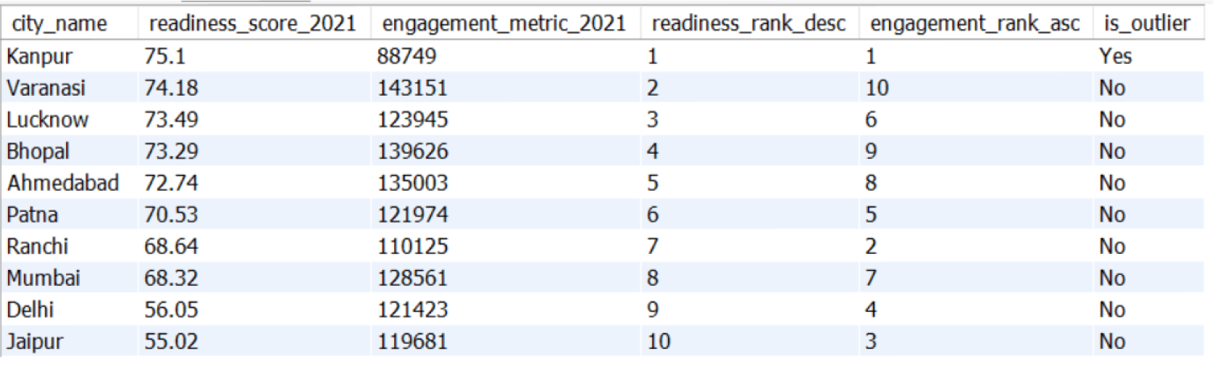
6. 2021 Readiness vs Pilot Engagement Outlier
Key Insights: Kanpur has the highest digital readiness but the lowest digital pilot engagement. Cities like Varanasi, Bhopal, and Lucknow show balanced readiness and engagement, implying steady adoption potential. Jaipur lags in both readiness and engagement.

Slide 12
Primary & Secondary Analysis

Slide 13
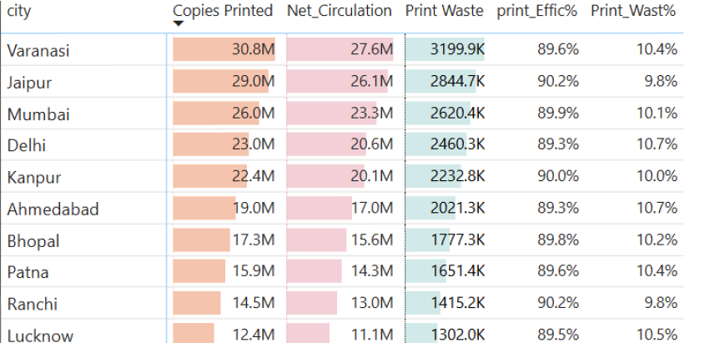
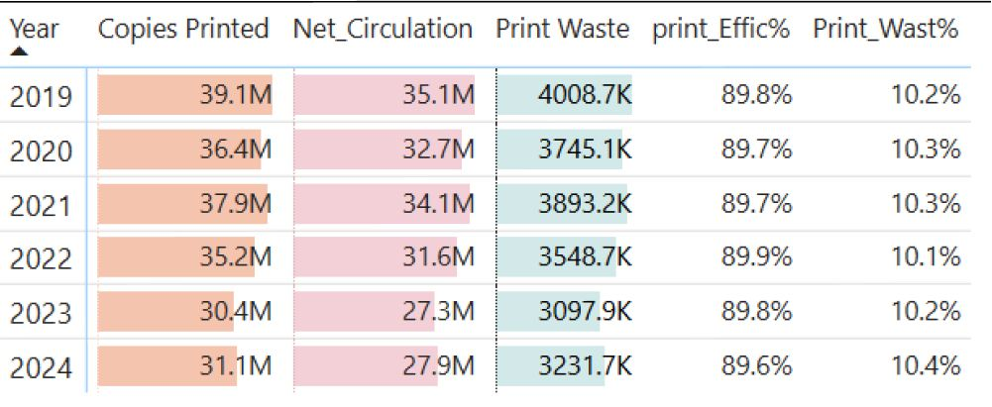
What is the trend in copies printed, copies sold, and net circulation across all cities from 2019 to 2024? How has this changed year-over-year?
Key Insights: Between 2019–2024, print operations saw a 60–85% decline in copies printed and net circulation across all cities Despite reduced volumes, print waste percentage remained constant (9–11%), reflecting no significant improvement in operational efficiency. This steady decline shows the need to speed up digital transformation and make print operations more efficient.

Slide 14
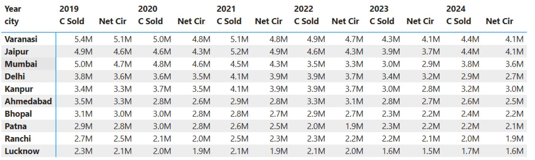
Which cities contributed the highest to net circulation and copies sold in 2024? Are these cities still profitable to operate in?
Key Insights: In 2024, Varanasi and Jaipur remain Bharat Herald’s largest print markets (4.1M net circulation each). However, even these strongholds have lost over 1M copies since 2019, indicating shrinking profitability. High-volume cities are no longer guaranteed profit centers; cost optimization and digital transition are critical even in core markets.

Slide 15
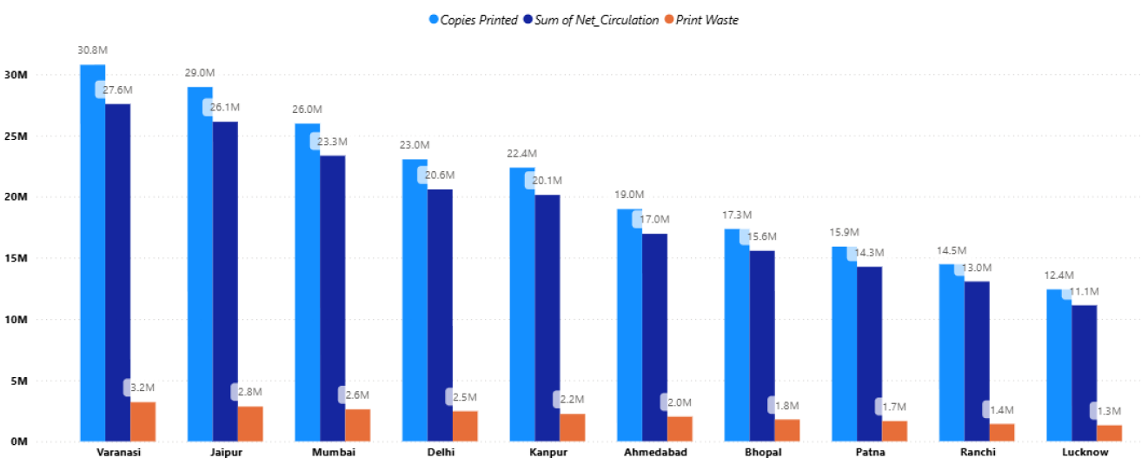
Which cities have the largest gap between copies printed and net circulation, and how has that gap changed over time?
Varanasi and Jaipur have the largest print waste, with over 3M copies gap between printed and circulated. Although total volumes have dropped since 2019, the gap has not reduced much, showing little improvement in print efficiency. Smaller cities like Ranchi and Patna waste fewer copies in total but lose a bigger share of their print runs, pointing to higher inefficiency

Slide 16
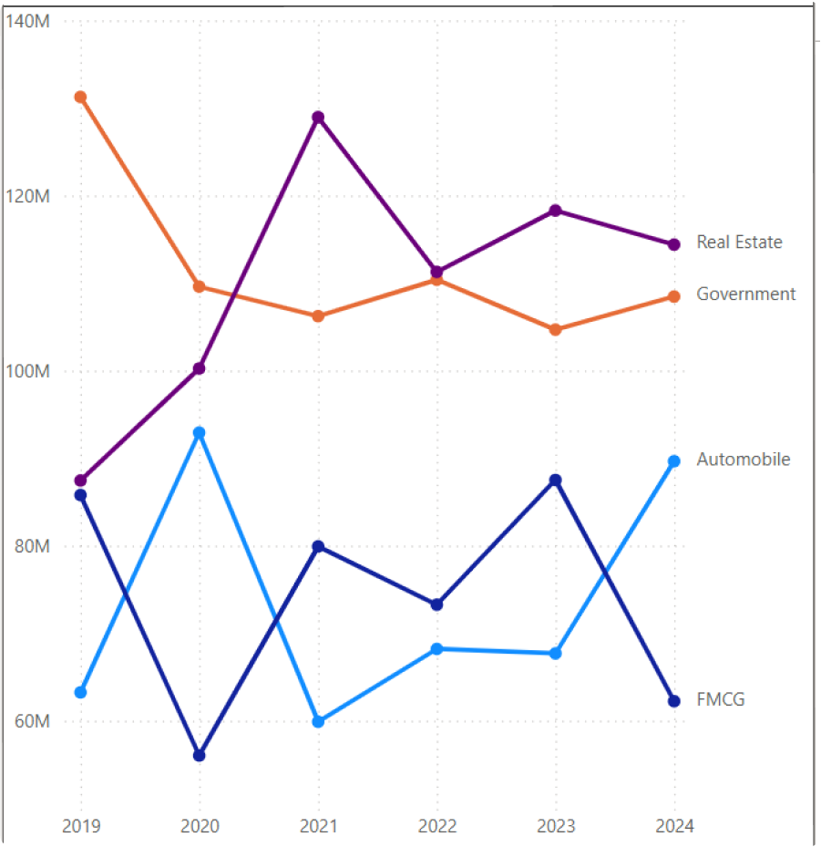
How has ad revenue evolved across different ad categories between 2019 & 2024? Which categories have remained strong, and which have declined?
Strong & Stable Real Estate – Rose from ~90 M in 2019 to a peak of ~135 M in 2021, still above 120 M in 2024. Government – High base (~135 M in 2019) but gradual softening to ~110 M in 2024, still a major contributor. Volatile but Recovering Automobile – Sharp swings (peak 92 M in 2020 → drop to 60 M in 2021 → back near 90 M in 2024), budgets returning. Weak- FMCG – Most inconsistent (85 M in 2019 → 55 M in 2020 → 90 M in 2023 → 62 M in 2024), lowest advertiser confidence.

Slide 17
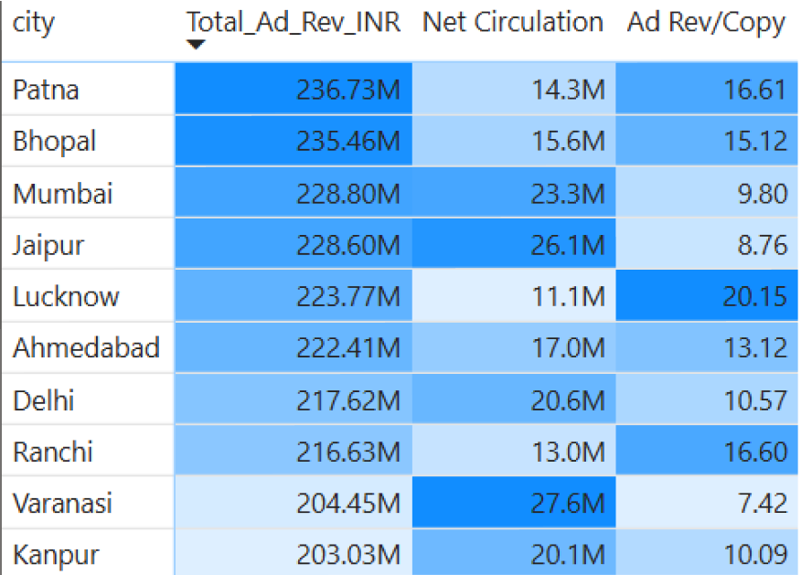
Which cities generated the most ad revenue, and how does that correlate with their print circulation?
Key Insights Patna, Bhopal, Mumbai, and Jaipur generated the highest total ad revenue. However, these cities differ widely in circulation. Patna & Bhopal have moderate net circulation (14–16M), whereas Mumbai & Jaipur have very high circulation (23–26M). There is no direct positive correlation between total circulation and total ad revenue. Smaller cities with niche readers earn more money per copy, while big cities with larger audiences earn less per copy but make it up with higher volume

Slide 18
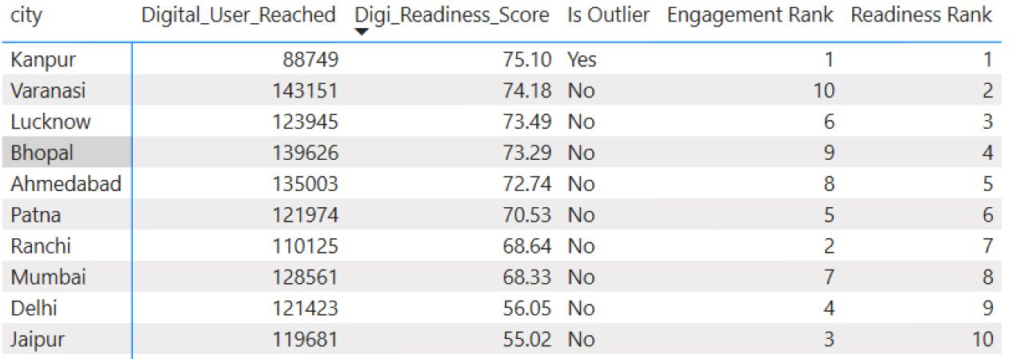
Which cities show high digital readiness (based on smartphone, internet, and literacy rates) but had low digital pilot engagement?
High Readiness, Low Engagement Kanpur shows the highest digital readiness (75.1) but also ranks lowest in engagement. This indicates strong infrastructure but weak pilot uptake — a key opportunity area. Top Readiness Performers: Varanasi (74.2), Lucknow (73.5), and Bhopal (73.3) also have high readiness scores but show better alignment between readiness and engagement .....

Slide 19
Which cities show high digital readiness (based on smartphone, internet, and literacy rates) but had low digital pilot engagement?....
Low Readiness Cities: Delhi (56.1) and Jaipur (55.0) have much lower readiness scores despite moderate engagement ranks — they may require foundational improvements before scaling digital initiatives. Focus on Kanpur to improve engagement campaigns, as its digital environment is already primed. Maintain momentum in Varanasi, Lucknow, and Bhopal where readiness and engagement are closer to balance.

Slide 20
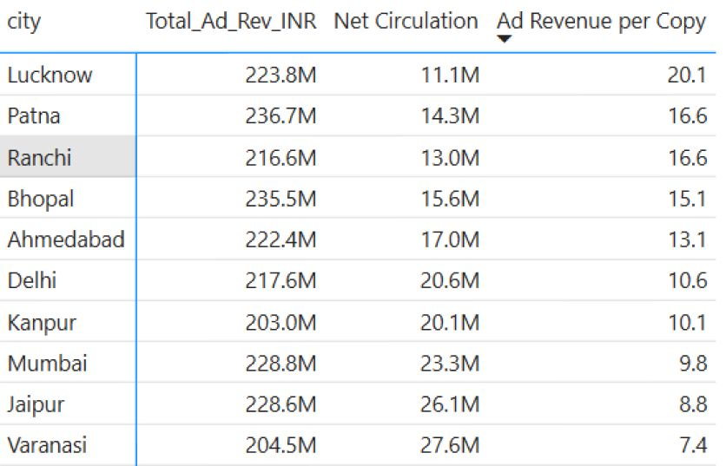
Which cities had the highest ad revenue per net circulated copy? Is this ratio improving or worsening over time?
Lucknow (₹20 per copy), Patna & Ranchi (₹17 per copy) are highest-yield cities despite smaller circulation. Varanasi (₹7 per copy) & Jaipur (₹9 per copy) have huge circulation but low yield per copy. High-volume cities are worsening in yield, while smaller premium cities are maintaining high returns. Focus on replicating premium ad strategies from top-yield markets.

Slide 21
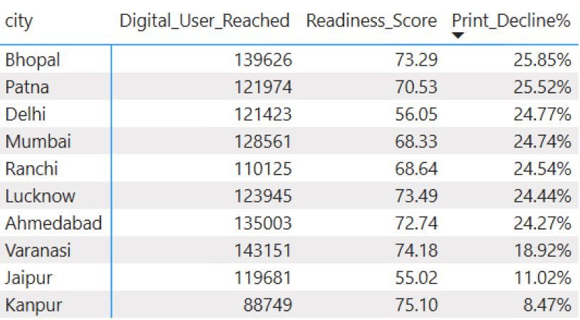
Based on digital readiness, pilot engagement, and print decline, which 3 cities should be prioritized for Phase 1 of the digital relaunch?
Bhopal – High digital readiness (73.3), large digital user base (139K) and highest print decline (25.9%). Clear sign of audience migrating to digital. Lucknow – High readiness (73.5), sizeable user base (124K) and steep print decline (24.4%). Urgent need to shift to digital. Varanasi – Largest digital user base (143K) with strong readiness (74.2) and moderate print decline (18.9%). Big market for rapid digital scaling.
Bhopal, Lucknow & Varanasi combine high digital readiness, large potential audiences, and weakening print performance, making them the strongest candidates for Phase 1 digital relaunch.

Slide 22
Further analysis & recommendations
What should Bharat Herald’s phased digital transition strategy look like, given the readiness and engagement data?

Slide 23

Phase 1 – Quick Wins (0–6 months)
Launch city-wise WhatsApp/Telegram news bulletins for top-tier cities.
Start digital registration drive: free newsletter sign-ups, push notifications, WhatsApp opt-ins.
Introduce “light” e-paper with simple pay-what-you-want or ₹10/week trial.
Optimize print operations (reduce wastage based on print decline %) to fund digital pilots.

Slide 24

Phase 2 – Scale & Monetize (6–18 months)
Roll out full-fledged apps with personalized feeds for Kanpur, Varanasi, Lucknow, Bhopal (the high readiness + high print decline cities).
Launch freemium model: free breaking news + paid premium analysis.
Phase 2 – Scale & Monetize (6–18 months)
Build niche vertical newsletters/podcasts (Real Estate, FMCG, Start-ups).
Start A/B testing paywalls and price points.

Slide 25

Phase 3 – Premium & Ecosystem (18–36 months)
Offer bundled memberships (news + podcasts + exclusive events).
Offer bundled memberships (news + podcasts + exclusive events).
Host virtual & in-person events (city awards, expos) sponsored by brands.
Deploy AI for translations, auto-summaries, and personalized push alerts to support multi-language expansion.
Embed news modules in partner super-apps (fintech, travel) for extra reach.

Slide 26
How can Bharat Herald regain advertiser trust in key cities or categories where confidence dropped the most?

Slide 27

Immediate Actions - Quickly rebuild credibility & reduce advertiser risk
Improve app usability and push-notification strategy in weak markets to grow active users.
Introduce trial ad packages and performance-linked pricing in weak categories (FMCG, Government).
Share success stories from top-performing cities to reassure advertisers.

Slide 28

Strategic Partnerships & Premium Inventory
Offer print + digital + events packages with exclusive ad slots in stronghold cities
Launch niche newsletters (Real Estate, Education, Start-ups) for targeted advertising.
Work with key advertisers to develop branded content, webinars, and local activations.
Use analytics to demonstrate campaign effectiveness and refine pricing.

Slide 29
What changes to content format or delivery (e.g., WhatsApp bulletins, mobile optimized e-papers) might boost digital engagement?

Slide 30



Daily WhatsApp / Telegram Bulletins Deliver short, bilingual “Top 10” headlines with images or 30-second explainers. Works brilliantly for Tier-2/Tier-3 audiences and keeps Bharat Herald visible on phones without needing an app download
Mobile-Optimized E-Paper & App Redesign the e-paper for thumb-friendly navigation: swipe pages, pinch-to-zoom, quick search, offline mode. Add push notifications for breaking news and personalised alerts by interest.
Audio & Short-Video News Launch 5-minute daily podcasts and 60-second Instagram Reels/YouTube Shorts summarizing key stories. Captures younger, on-the-go audiences and builds habit beyond print.

Slide 31
What role can subscription bundling, loyalty programs, or pay-per-article models play in revenue recovery?

Slide 32

Subscription Bundling
One fee covers e-paper + podcasts + newsletters + WhatsApp alerts. Offer one affordable ‘all-access pass’ — e-paper, podcasts, newsletters and WhatsApp alerts together. Start with a low-priced ₹99/month bundle to attract users, then upsell a premium tier with ad-free reading and exclusive reports.”
Loyalty Program
Reward readers for reading, sharing, referring or renewing with perks like exclusive webinars, local event invites and early access to investigations. This builds a community of engaged members that advertisers value. Start with a free ‘Bharat Herald Insider’ club, then introduce a paid VIP tier for extra benefits
Pay-Per-Article
Offer pay-per-article access so occasional readers can buy single premium stories. Perfect for new or infrequent users. Keep it for investigative or hyperlocal exclusives while leaving mainstream news free to maximise reach

Slide 33
How can Bharat Herald leverage local influencers or journalists to re-establish digital credibility in regional markets?

Slide 34

Build a ‘Local Voices’ network — recruit respected regional journalists and micro-influencers to create short, mobile-first explainers and live updates in local languages. Publish these on WhatsApp, Instagram, and the Bharat Herald app as verified content with their names and faces. Give them editorial freedom within guidelines and feature a ‘Verified by Bharat Herald’ badge to signal authenticity.”
Why This Works: Trust Transfer: People trust familiar local figures more than anonymous news feeds. Faster Reach: Micro-influencers already have engaged audiences on WhatsApp, Instagram, and YouTube. Regional Relevance: Local language content feels authentic and fits regional issues. Credibility Signal: “Verified by Bharat Herald” badge + transparent bios rebuild confidence after print decline.

Slide 35
Conclusion
Print circulation is in steady decline (2019–2024), making digital transition unavoidable. Ad revenues are uneven – premium cities earn more per copy, but mass markets rely on volume. Digital readiness is strong in many cities, but engagement lags, showing a gap between potential and adoption. High print waste in top cities (Varanasi, Jaipur) indicates operational inefficiency. Top risk cities (Varanasi, Ranchi, Mumbai) must be prioritized for digital-first strategies. Advertiser trust can be rebuilt by combining audience engagement data + bundled digital offerings. Sustainable growth depends on hybrid models — e-papers, mobile bulletins, loyalty programs, and influencer-led regional strategies. Key takeaway: Bharat Herald must shift from being just a legacy print brand to becoming a modern, multi-platform news ecosystem.

Slide 36
Thank you
Sushma R

